Slide 1


Advanced
Robotic Process Automation
Inventory Order Placing System
210701509
Vinoth Raj G
Guide Name: Mr. B.Bhuvaneswaran
Designation and Department:
Assistant Professor (SG), CSE

Slide 2
Abstract
The aim of this project is to design and implement an inventory management system for a retail store that sells products. The project is motivated by the need to improve the efficiency and accuracy of inventory operations and to enhance customer satisfaction. Implementing an inventory management system for a specific business or organization to achieve accuracy and effective cost management and reduce the losses in the organization.

Slide 3
Need for the Proposed System
It saves money by reducing inventory costs, such as storage, handling, obsolescence, and losses.
It improves cash flow by spending money on inventory that sells, so cash is always moving through the business.
It satisfies customers by providing them with the items they want without waiting or facing out-of-stock situations.

Slide 4
Advantages of the Proposed System
It reduces the risk of overselling by preventing the sale of items that are out of stock or on backorder.
It saves money by reducing inventory costs, such as storage, handling, insurance, and losses.
It improves cash flow by spending money on inventory that sells, so cash is always moving through the business.
It satisfies customers by providing them with the items they want without waiting or facing out-of-stock situations.

Slide 5
Literature Survey
Performance improvement of inventory management system processes by an automated warehouse management system
Advantages
An automated warehouse management system is an essential replacement for a manual management system.
The main purpose of automating the warehouse system is to control the movement and storage of the products, together with the benefit of enhanced security and quicker handling.
The newly created software upgraded the capabilities of the warehouse management system.
Disadvantages
While performing studies for optimal processes, the type of the label printer was also taken into account in a way that will help reducing the cost, while choosing the printer a certain specifications were taken into account; maintenance and row material requirements (ink and paper), printing speed and quality.

Slide 6
Literature Survey
Warehouse inventory management system using IoT and open source framework
Advantages
The total system gives an archetype to correspond the information flow and material flow.
The web page which is built in accordance to provide convenient and an interface to the user to track the products.
The developed system results a very low cost system and works dynamically compared with the existing present warehouse inventory management systems.
Disadvantages
In future, this innovation can be used in several areas in different applications and many enhancements can be done so that it can be made available to all the sectors

Slide 7
Main Objective
To ensure a continuous supply of materials and stock so that production and customer demand are not affected by shortages or delays.
To avoid both overstocking and understocking of inventory, which can result in higher costs, lower profits, and lower customer satisfaction.
To reduce inventory-related expenses, such as storage, handling, insurance, obsolescence, and losses.
To improve cash flow and profitability by spending money on inventory that sells and generating revenue from sales.

Slide 8



Architecture
RE Framework
Read Excel Sheet
Send Mail
Write Excel Sheet
BODY OF THE MAIL
TXT FILE
ITEM STOCK
ORDERED STOCK

Slide 9
System Requirements
Hardware
Processor AMD : Ryzen 3 3250U with Radeon Graphics 2.60 GHz
Installed RAM: 8.00 GB (5.94 GB usable)
Edition: Windows 11 Home Single Language
Software
Microsoft Excel
UiPath Studio
UiPath Assistant
Internet Explorer

Slide 10


Functional Description
Excel Processing
  Opening the Excel and processing the stock quantity to identify the products to be ordered with their quantity
Activity Diagram
UiPath Studio
Read Excel
Check
Min Stock > Available
Create / Update Stock Details
Write Excel
Ordered Stock = Max Stock - Available

Slide 11


Functional Description
Mail Sending
  Based on the processed Datatable, the UiPath Studio uses use Gmail activity with text content to send mail to individual suppliers with quantity.
Activity Diagram
Processed Datatable
UiPath Studio
Gmail
Body of the mail
Supplier

Slide 12
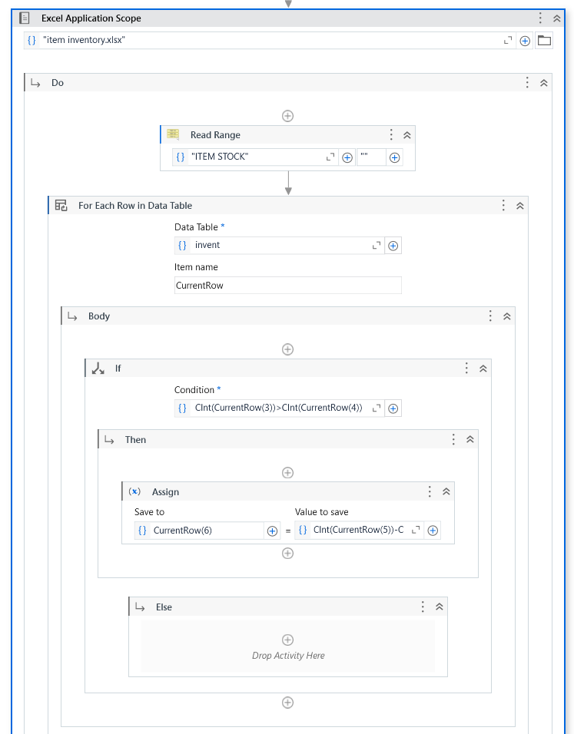
Process Design
Main Process

Slide 13
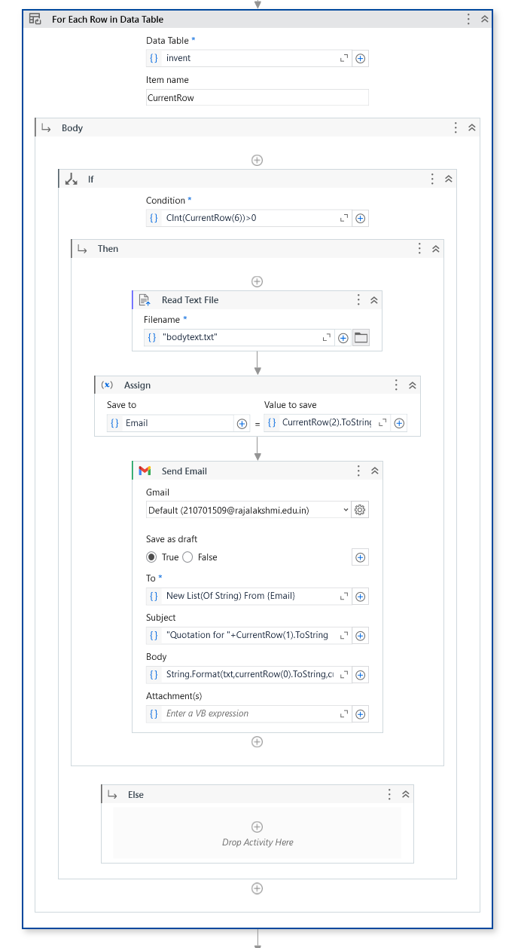
Process Design
Sub Process

Slide 14
Table Design
ORDERED STOCK
Product Name
Supplier
Supplier Email
Minimum Quantity
Available Quantity
Maximum Quantity
Ordered Quantity
ITEM STOCK
Product Name
Supplier
Supplier Email
Minimum Quantity
Available Quantity
Maximum Quantity

Slide 15
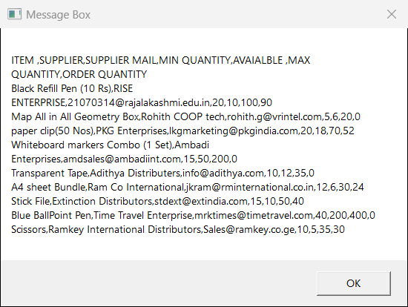
Implementation
Excel Processing
  The processing of Excel takes place when user initiates the process to collect the data on how much the product to be ordered
Screen shots

Slide 16
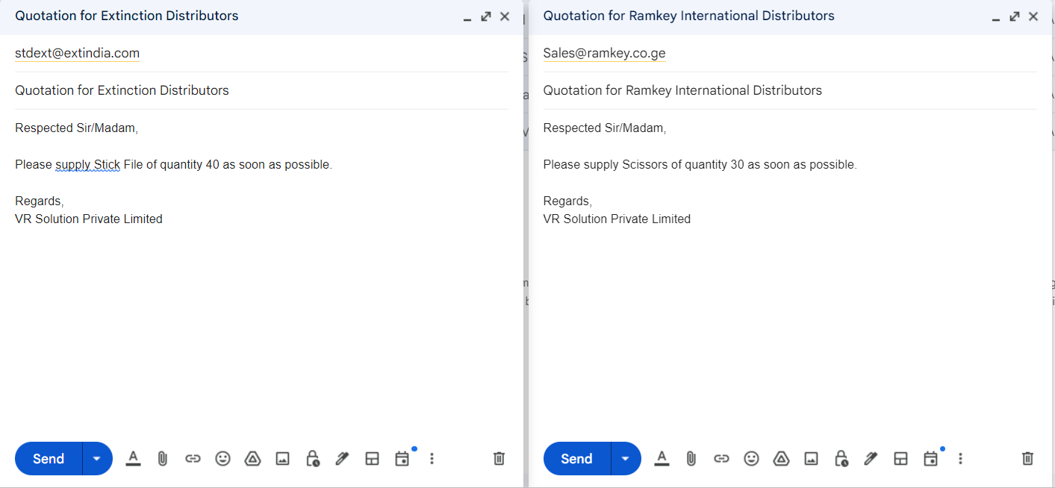
Implementation
Mail Sending
  The Mail will be send to each supplier based on the data in the datatable with ordered quantity
Screen shots

Slide 17
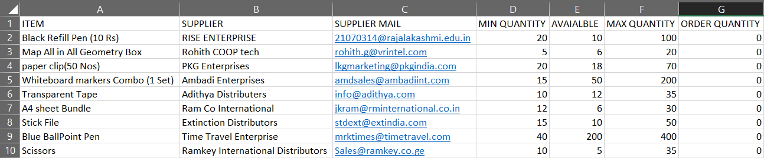
Testing
Description
By giving a sample of 10 products in the excel sheet. The testing of the process created in Uipath Studio.

Slide 18
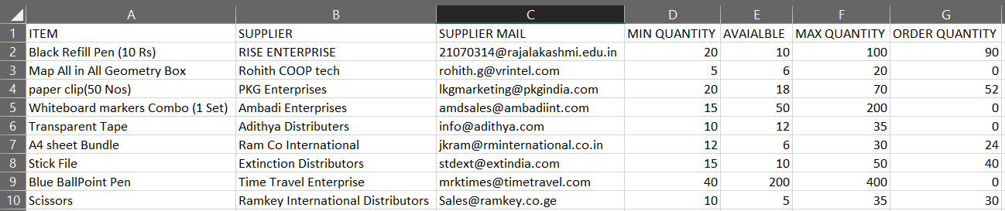
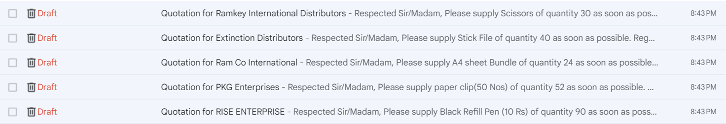
Testing
Test Result Screenshot
Excel Sheet Result
Gmail Test Result

Slide 19
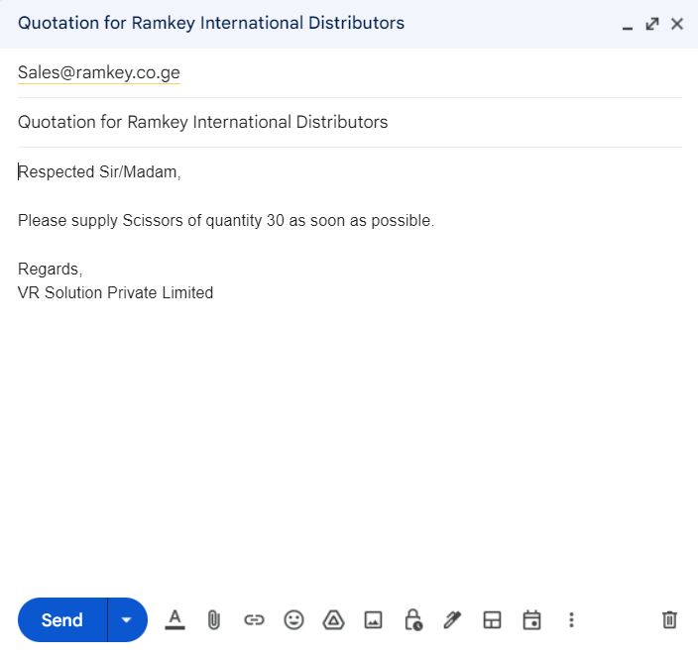
Testing
Test Result Screenshot
Gmail Result

Slide 20
Conclusions
The implementation of an efficient and streamlined inventory order placing system is essential for the smooth operation and success of any business.
By utilizing advanced technologies and optimizing the procurement process, companies can significantly improve their inventory management and overall productivity.
A well-designed inventory order placing system can effectively minimize stockouts, reduce excess inventory, and enhance cost-effectiveness through better demand forecasting and inventory tracking.

Slide 21
Future Enhancement
Integration of Machine Learning:
Implement advanced algorithms to predict demand patterns, optimize inventory levels, and automate the replenishment process. This can help in achieving greater accuracy in inventory forecasting and minimize the risk of overstocking or stockouts.
Blockchain Integration:
Incorporate blockchain technology to enhance transparency and security in supply chain transactions, ensuring the authenticity of product information and facilitating seamless tracking of inventory movements.

Slide 22
IEEE Paper
Inventory Management Algorithm and System Implementation Based on Ant Colony Algorithm:
Xiaojun Rao
Jiangxi University of Applied Science, Nanchang, Jiangxi, China
Seiton: A Mobile Inventory Management System Application for Micro, Small and Medium-sized Enterprise:
Ashley Marie N. Margate
School of Industrial Engineering and Engineering Management, Mapúa University, Manila, Philippines
Ma. Cathyrine F. Ravina
School of Industrial Engineering and Engineering Management, Mapúa University, Manila, Philippines

Slide 23
References
Hansen, O., Transchel, S., & Friedrich, H. (2023). Replenishment strategies for lost sales inventory systems of perishables under demand and lead time uncertainty. European Journal of Operational Research, 308(2), 661-675.
Kumar, A., Santra, P. K., & Mahapatra, G. S. (2023). Fractional order inventory system for time-dependent demand influenced by reliability and memory effect of promotional efforts. Computers & Industrial Engineering, 179, 109191.
Berling, P., Johansson, L., & Marklund, J. (2023). Controlling inventories in omni/multi-channel distribution systems with variable customer order-sizes. Omega, 114, 102745.
Reiman, M. I., Wan, H., & Wang, Q. (2023). Asymptotically Optimal Inventory Control for Assemble-to-Order Systems. Stochastic Systems, 13(1), 128-180.
Malmberg, F., & Marklund, J. (2023). Evaluation and control of inventory distribution systems with quantity based shipment consolidation. Naval Research Logistics (NRL), 70(2), 205-227.

Slide 24
Queries

Slide 25
Demonstration

Slide 26
Thank You

